Slide 1
UMC eProcurement Portal
Module: General
User Manual

Slide 2
Table of Content
1.Login system
2. Step by Step
News Search (Admin)
Template Publish(Admin)
Template List(User,Admin)
PO Terms(User,Admin)
Personal Data Protection Statement(User,Admin)
Support History(Admin)
Backend Job(Admin)

Slide 3
Table of Content
Contact List/Contact Me(User,Admin)
Cycle Time Report(Admin)
Message Inbox(User,Admin)
FAQ(User,Admin)

Slide 4
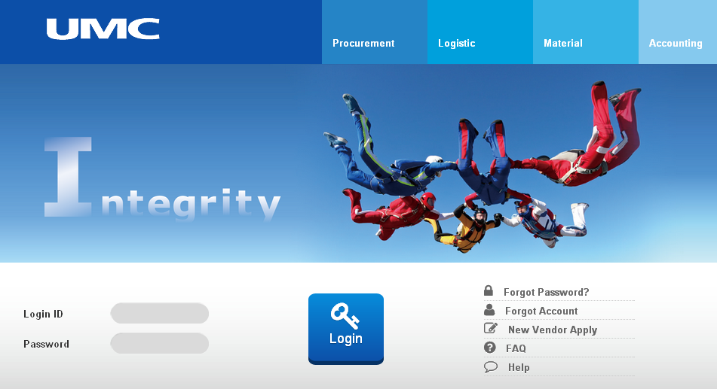
1. Login System
eProcurement：https://mybuyer.umc.com/
1
3
2

Slide 5
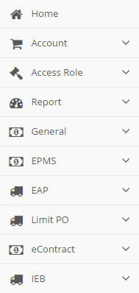
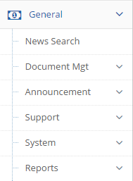
2. Step by Step
1) News Search (Admin)
2
Step 1:
Click on the branch “General” of function tree.
Step 2:
Click on the node “News Search”, then it will redirect to the News List page.
1

Slide 6
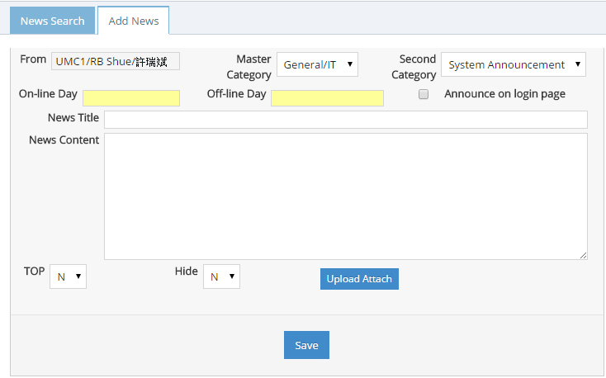
2. Step by Step
1) News Search (Admin)
3
4
Step 3: Click on the title “Add News” of page top.
Step 4: Input news information and content.
**fields in yellow background are required.

Slide 7
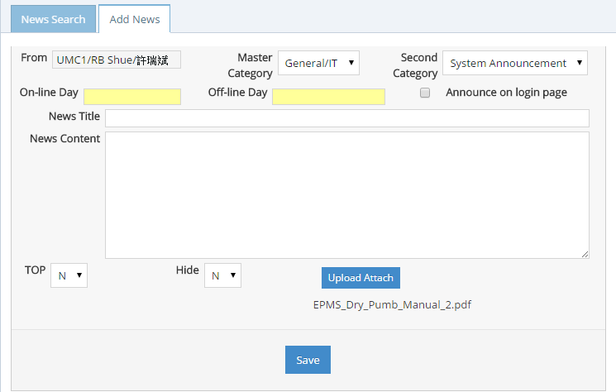
2. Step by Step
1) News Search (Admin)
5
Step 5: Press “Upload Attach” button to select publish file.

Slide 8
2. Step by Step
1) News Search (Admin)
7
8
Step 8: Press “Save” button to add news

Slide 9
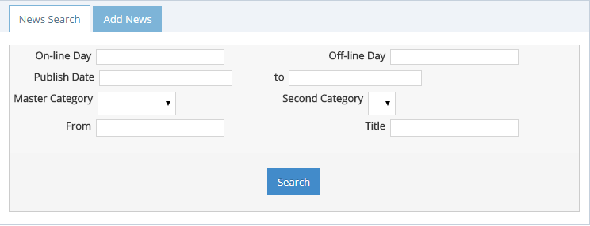
2. Step by Step
1) News Search (Admin,User)
9
10
11
Step 10 : Input Search condition.
Step 11 : Press “Search” button to show search result
Step 9 : Click on the title “ News Search” of page top.

Slide 10
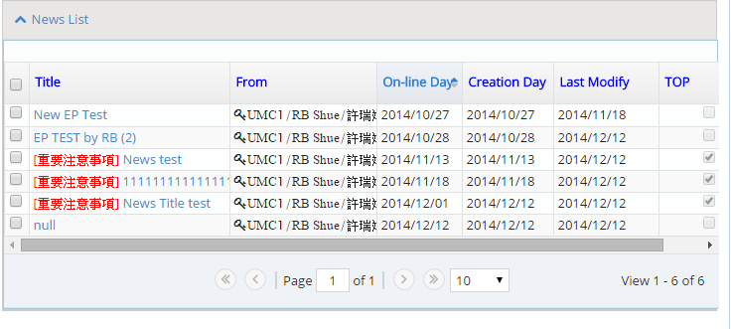
2. Step by Step
1) News Search (Admin)
12
Step 12 :On the page News List, users can read data including Title, From, On-line Day, and etc, that is corresponding to this News.

Slide 11
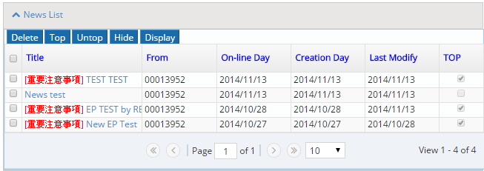
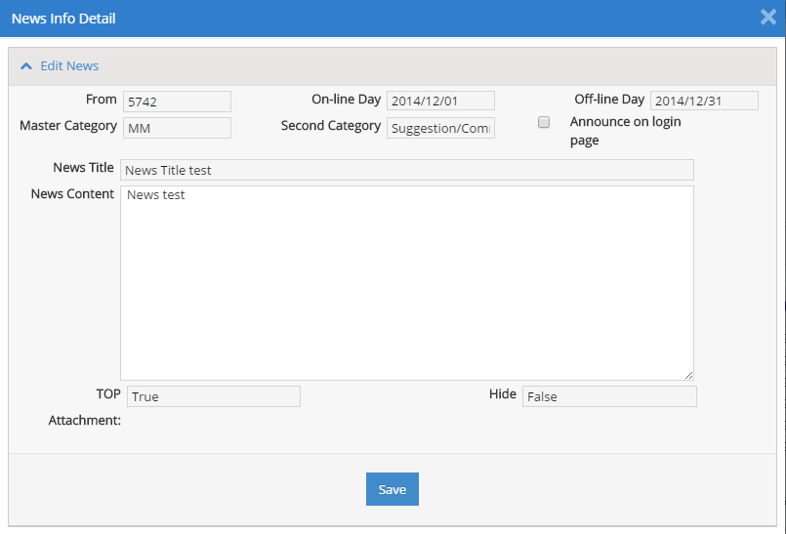
2. Step by Step
1) News Search (Admin)
13
Step 13 :Click on the hyper link “Title” to display the details of the News.

Slide 12
2. Step by Step
1) News Search (Admin)
14
15
Step 14: Input edit data.
Step 15: Press “Save” button to save News.
**Only admin can edit news content.

Slide 13
2. Step by Step
1) News Search (Admin)
16
Step 16 : Buttons “Delete”, “Top”, ”Untop”, “Hide” and “Display” allow,
Delete: Delete selected news.
Top: Top selected news.
Untop: Untop selected news.
Hide: Hide selected news.
Display: Display selected news.
**Only admin can use “Delete”, “Top”, ”Untop”, “Hide” and “Display” function.

Slide 14
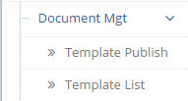
2. Step by Step
2) Template Publish(Admin)
3
2
Step 1:
Click on the branch “General” of function tree.
Step 2:
Click on the branch ” Document Mgt” of sub-function tree.
Step 3:
Click on the node “Template Publish”, then it will redirect to the Document Management Template Publish page.
1

Slide 15
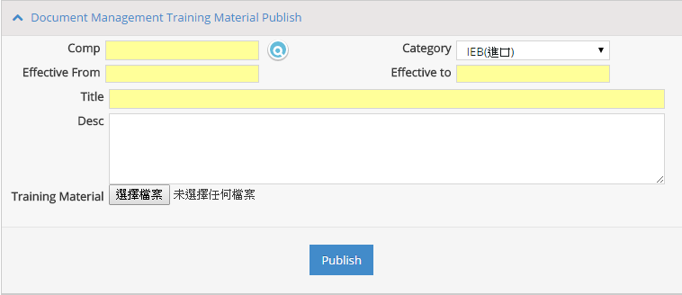
2. Step by Step
2) Template Publish(Admin)
4
5
Step 4: Input document information.
**fields in yellow background are required.
Step 5: Press “choice a file” button to select template file.

Slide 16
2. Step by Step
2) Template Publish(Admin)
6
Step 6: Show you select file name.

Slide 17
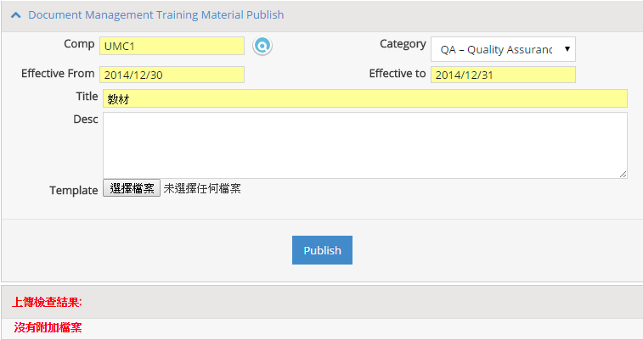

2. Step by Step
2) Template Publish(Admin)
7
8
Step 7: Press “Publish” button to publish file.
Step 8: Show success or error message.

Slide 18
2. Step by Step
3) Template List(User,Admin)
2
3
Step 1:
Click on the branch “General” of function tree.
Step 2:
Click on the branch ” Document Mgt” of sub-function tree.
Step 3:
Click on the node “Template Publish”, then it will redirect to the Document Management Template List page.
1

Slide 19
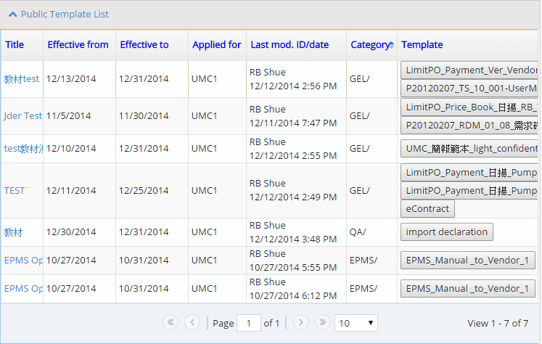
2. Step by Step
3) Template List(User,Admin)
4
Step 4: Show Template list.

Slide 20
2. Step by Step
3) Template List(User,Admin)
5
6
Step 5: Click hyperlink of title to edit document template detail.
Step 6: Press template list to download .

Slide 21
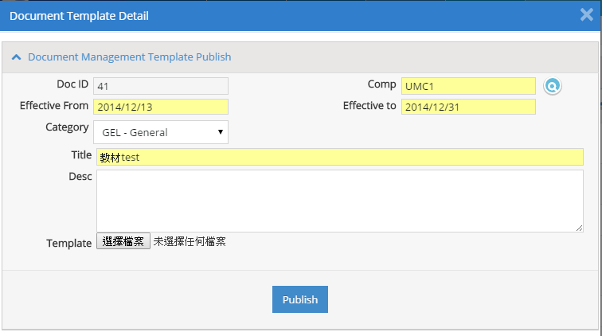
2. Step by Step
3) Template List(User,Admin)
7
8
Step 7: Edit comp,effective from ,effiective to, category , title , desc.
Step 8: Press “Choice a file” button to select template file.

Slide 22
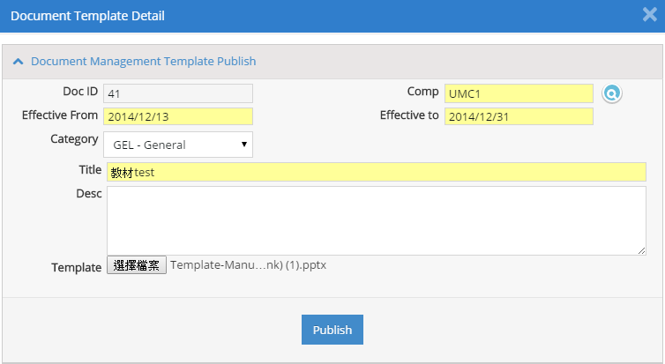
2. Step by Step
3) Template List(User,Admin)
9
Step 9: Show you selected file name.

Slide 23
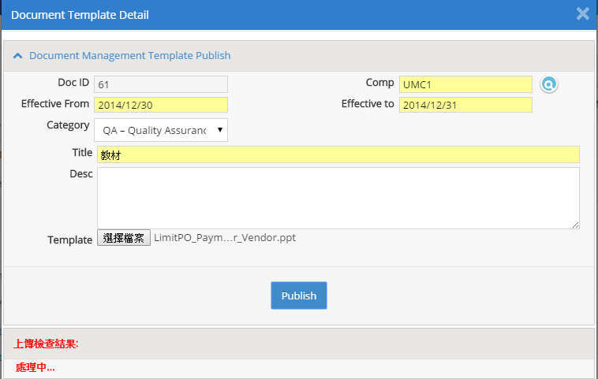
2. Step by Step
3) Template List(User,Admin)
11
10
Step 10: Press “Publish” button to publish file.
Step 11: Show success or error message.

Slide 24
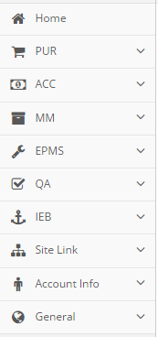
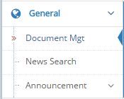
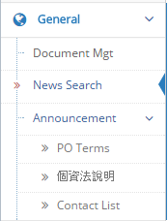
2. Step by Step
4) PO Terms(User,Admin)
2
3
Step 1:
Click on the branch “General” of function tree.
Step 2:
Click on the branch ”Announcement” of sub-function tree.
Step 3:
Click on the node “PO Terms”, then it will redirect to the PO Terms page.
1

Slide 25
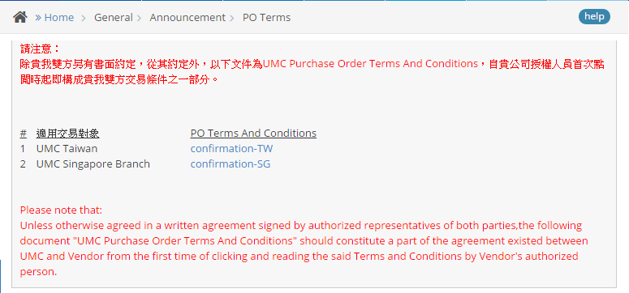
2. Step by Step
4) PO Terms(User,Admin)
4
Step 4: Show PO Terms.

Slide 26
2. Step by Step
5) Personal Data Protection Statement(User,Admin)
2
3
1
Step 1:
Click on the branch “General” of function tree.
Step 2:
Click on the branch ”Announcement” of sub-function tree.
Step 3:
Click on the node “Personal Data Protection Statement ”, then it will redirect to the Personal Data Protection Statement page.

Slide 27
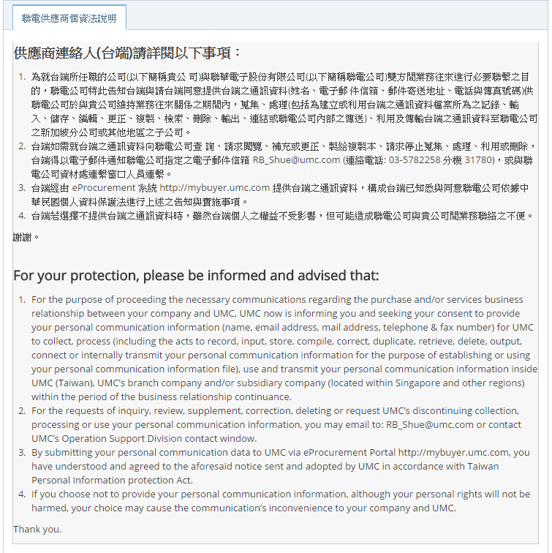
2. Step by Step
5) Personal Data Protection Statement(User,Admin)
4
Step 4: Show Personal Data Protection Statement.

Slide 28
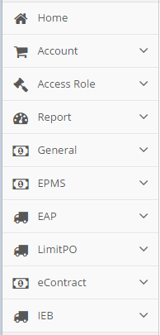
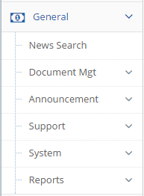
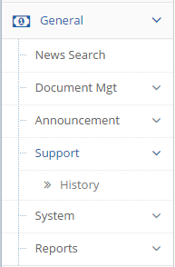
2. Step by Step
6) Support History(Admin)
Step 1:
Click on the branch “General” of function tree.
Step 2:
Click on the branch ”Support” of sub-function tree.
Step 3:
Click on the node “History”, then it will redirect to the History Question Searching page.
1
3
2

Slide 29
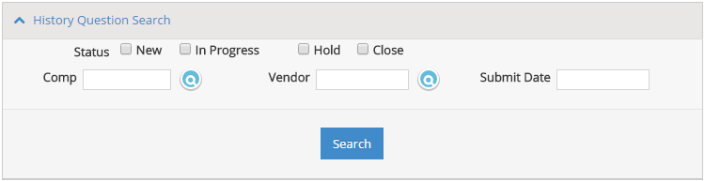
2. Step by Step
6) Support History(Admin)
4
5
Step 4: Input Search condition.
Step 5: Press “Search” button to show search result.

Slide 30
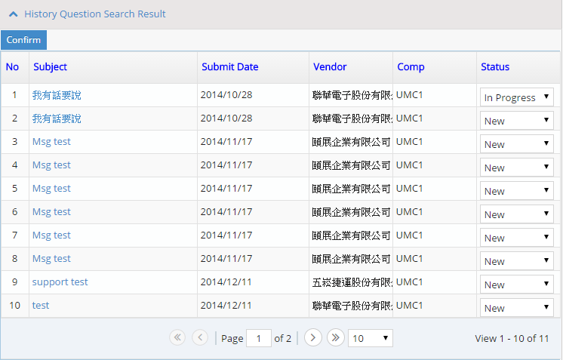
2. Step by Step
6) Support History(Admin)
6
Step 6: On the page History Question Search Result, users can read data including Subject, Submit Date, Vendor, and etc, that is corresponding to this history question.

Slide 31
2. Step by Step
6) Support History(Admin)
7
Step 7: Click on the hyper link “Subject” to display the details of the histiory question.

Slide 32
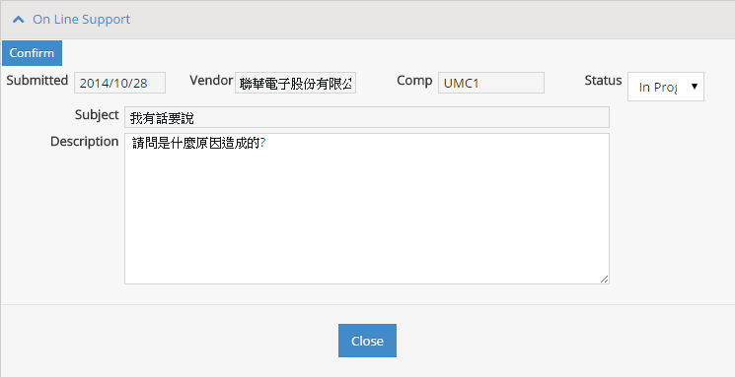
2. Step by Step
6) Support History(Admin)
9
8
Step 8: Change the processing status of on line support.
Step 9: Press ”Confirm” button to save change.

Slide 33
2. Step by Step
6) Support History(Admin)
11
10
Step 10: User can also change all question processing status on the grid .
Step 11: Press “Confirm” button to save all changes.

Slide 34
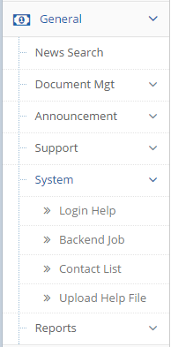
2. Step by Step
7) Backend Job(Admin)
Step 1:
Click on the branch “General” of function tree.
Step 2:
Click on the branch ”System” of sub-function tree.
Step 3:
Click on the node “Backend Job”, then it will redirect to the Backend Job Searching page.
1
2
3

Slide 35
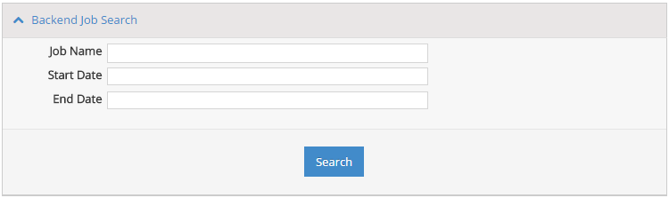
2. Step by Step
7) Backend Job(Admin)
4
5
Step 4: Input Search condition.
Step 5: Press “Search” button to show search result.

Slide 36
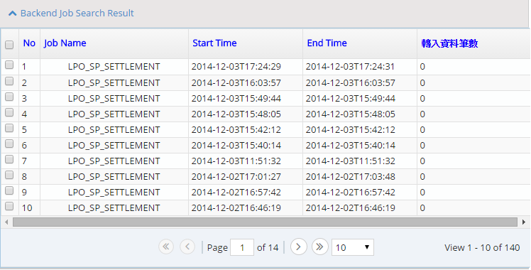
2. Step by Step
7) Backend Job(Admin)
Step 6: On the page Backend Job Search Result, users can read data including Job Name, Start Time, End Time, and etc, that is corresponding to this backend job.

Slide 37
2. Step by Step
8) Contact List/Contact Me(User)
2
3
Step 1:
Click on the branch “General” of function tree.
Step 2:
Click on the branch ”Announcement” of sub-function tree.
Step 3:
Click on the node “Contact List”, then it will redirect to the Contact List page.
1

Slide 38

2. Step by Step
8) Contact List/Contact Me(User)
4
5
Step 4: User can also click on the banner “Contact Me”, then it will redirect to the Contact Me page.
Step 5: Show Contact List.

Slide 39
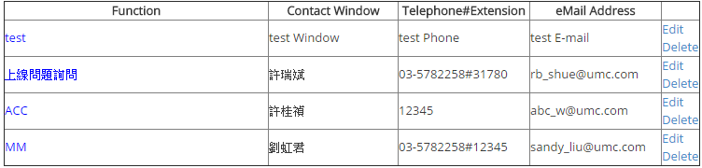
2. Step by Step
8) Contact List/Contact Me(Admin)
8
＊＊Only admin can edit or delete contact list.

Slide 40
2. Step by Step
8) Contact List/Contact Me(Admin)
9
Step 9 :Click on the hyper link “Edit” to display the details of contact.

Slide 41
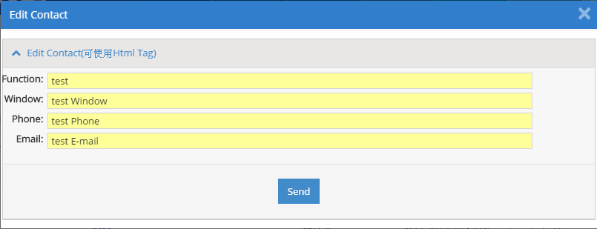
2. Step by Step
8) Contact List/Contact Me(Admin)
10
Step 10 :Maintain contact window information.
Step 11 :Press “Send” button to save contact.

Slide 42
2. Step by Step
8) Contact List/Contact Me(Admin)
12
Step 12 :Click on the hyper link “delete” to delete contact.

Slide 43
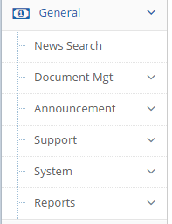
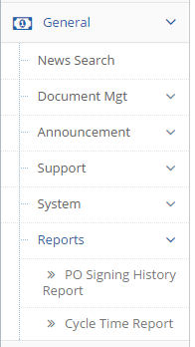
2. Step by Step
9) Cycle Time Report(Admin)
2
3
Step 1:
Click on the branch “General” of function tree.
Step 2:
Click on the branch ”Reports” of sub-function tree.
Step 3:
Click on the node “Cycle Time Report”, then it will redirect to the Report page.
1

Slide 44
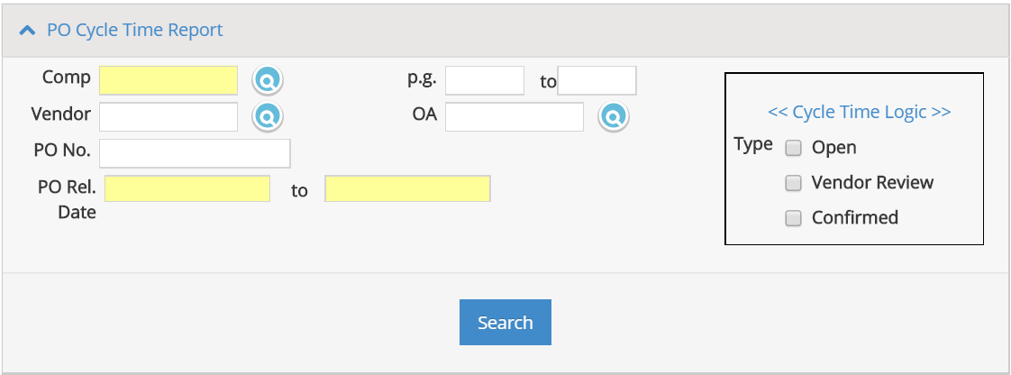
2. Step by Step
9) Cycle Time Report(Admin)
4
5
Step 4: Input Search condition.
**fields in yellow background are required.
Step 5: Press Search button.

Slide 45
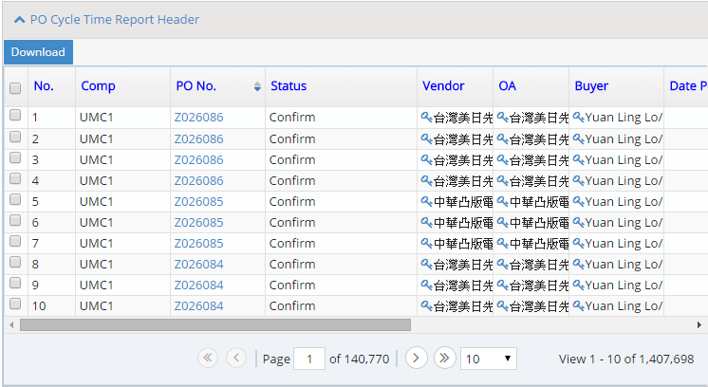
2. Step by Step
9) Cycle Time Report(Admin)
6
Step 6: On the page PO Cycle Time Report header, users can read data including No, Comp, Po No. and etc, that is corresponding to this Cycle Time Report header.

Slide 46
2. Step by Step
9) Cycle Time Report(Admin)
**Click on the hyper link “PO no” to display the PO View.

Slide 47
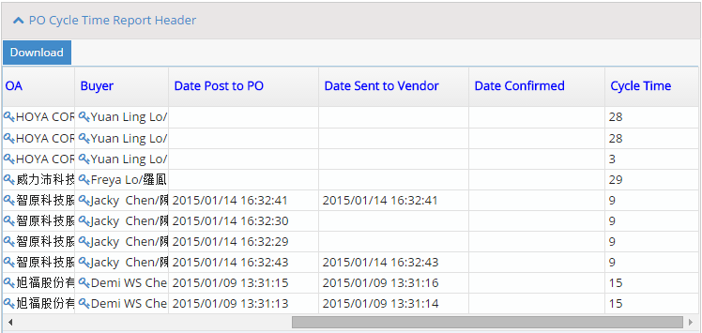
2. Step by Step
9) Cycle Time Report(Admin)
7
IN Cycle Time field shows PO cases process cycle time.

Slide 48
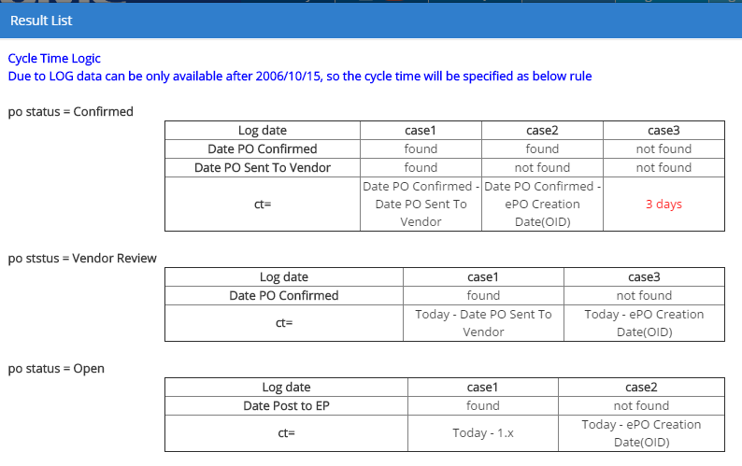
2. Step by Step
9) Cycle Time Report(Admin)
7
Step 7: Click “Cycle Time Logic” hyper link to view cycle time count rules.

Slide 49
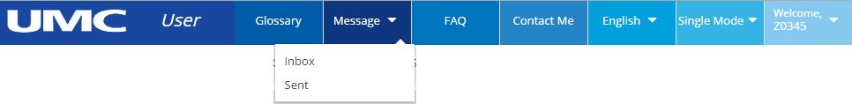
2. Step by Step
10) Message Inbox(User,Admin)
1
2
Step 1: Click on the branch ”Message” of banner.
Step 2: Click on the node “Inbox”, then it will redirect to the Inbox page.

Slide 50
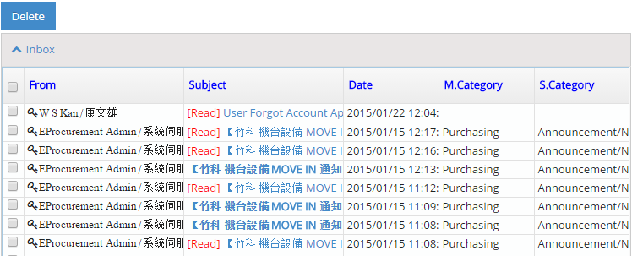
2. Step by Step
10) Message Inbox(User,Admin)
Step 3: System will show all received messages, press “Delete” button to delete selected messages.

Slide 51
2. Step by Step
11) FAQ(User,Admin)
1
Step 1: Click on the banner “FAQ”, then it will redirect to the FAQ page.

Slide 52
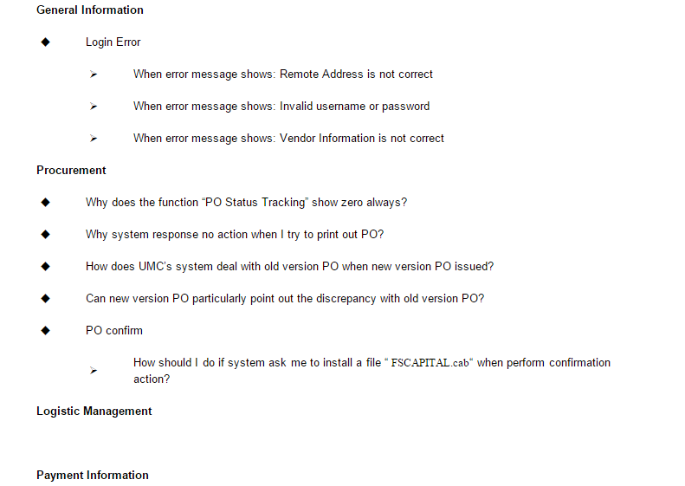
2. Step by Step
10) FAQ(User,Admin)
2
Step 2: Show FAQ question. Click one of question ,then it will outline answers.

Slide 53
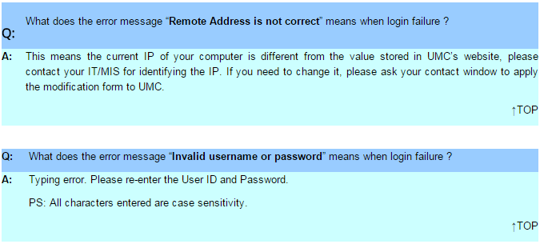
2. Step by Step
10) FAQ(User,Admin)
3
Step 3: Show FAQ answer.

Slide 54
Thank you!

